Slide 1

Database Access Control Models & Techniques
By:
Kapil Jhade
17BCS013
GUIDED BY: Dr. UMA SHADRI

Slide 2
Content
Threats to Database Security
Database Security Models
Access Control
Types of Access Controls
Access Control Models
Discretionary Access Control (DAC)
Mandatory Access Control (MAC)
Role - Based Access Control(RBAC)
Conclusion
References

Slide 3

Access Control
Protecting what needs to be protected with the available technologies!
• Access control is the of Information Security!

Slide 4
Threats to Database Security
Threat 1 - Excessive Privilege Abuse
Threat 2 - Legitimate Privilege Abuse
Threat 3 - Platform Vulnerabilities
Threat 4 - SQL Injection
Threat 5 - Denial of Service
Threat 6 - Weak Authentication

Slide 5
Database Security Models
Security models are the formal description of security policies. Security models are useful tools for evaluating and comparing security policies. Security models allow us to test security policies for completeness and consistency. They describe what mechanisms are necessary to implement a security policy.

Slide 6
Database Security Models
Security models are described in terms of the following elements:
Subjects: Entities that request access to objects.
Objects: Entities for which access request is being made by subjects.
Access Modes: Type of operation performed by subject on object (read, write etc).
Policies: Enterprise wide accepted security rules.
Authorizations: Specification of access modes for each subject on each object.
Administrative Rights: Who has rights in system administration and what responsibilities administrators have.
Axioms: Basic working assumptions.

Slide 7
Access Control
The purpose of access control is to limit the actions or operations that a legitimate user of a computer system can perform.
Access control constraints what a user can do directly, as well as what programs executing on behalf of the users are allowed to do.
In this way access control seeks to prevent activity that could lead to a breach of security

Slide 8
Access Control
Access control is enforced by a reference monitor which mediates every attempted access by a user to objects in the system. The reference monitor consults an authorization database in order to determine if the user attempting to do an operation is actually authorized to perform that operation. The administrator sets these authorizations on the basis of the security policy.

Slide 9
Access Control Vs Authentication
Access control is different from authentication. Authentication is a process of signing on to a computer system by providing an identifier and a password. So, correctly establishing the identity of the user is the responsibility of the authentication service. On the other hand, access control assumes that authentication of the user has been successfully verified prior to enforcement of access control via a reference monitor.

Slide 10
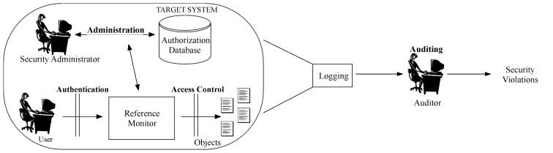
Access Control

Slide 11
Types of Access Controls
• There are three types of Access Controls:
– Administrative controls : Define roles, responsibilities, policies, and administrative functions to manage the control environment.
– Technical controls : Use hardware and software technology to implement access control.
– Physical controls : Ensure safety and security of the physical environment.

Slide 12
Access Control Models
Three major Access control models are:
Discretionary Access Control (DAC)
Mandatory Access Control (MAC)
Role - Based Access Control (RBAC)

Slide 13
Discretionary Access Control (DAC)
Discretionary Access Control (DAC)- least restrictive model
Every object has owner, who has total control of that object.
Owner can create and access their objects freely.
Owners can give permissions to other subjects over these objects.
DAC used on operating system like unix and microsoft windows.
DAC has two significant weakness:
DAC relies on decisions by end users to set proper level of security, incorrect permission might be granted to subject or permissions might be given to unauthorised subject.
Subjects permissions will be inserted by any programs that subject executes. Attackers often take advantage of the inheritance because of end users.

Slide 14
Discretionary Access Control (DAC)
The System R Authorization Model:
The model supports decentralized administration of authorizations. Any database user is authorized to create a new table; once the table is created he becomes the owner of the table and is fully authorized to exercise all privileges on the table. The owner can also grant all privileges on the table to other users.
Possible relational databases privileges user can exercise on tables are select, insert, delete and update.

Slide 15
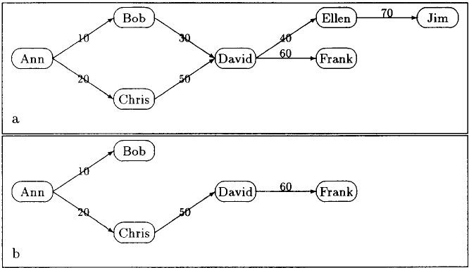
Discretionary Access Control (DAC)
The System R Authorization Model Example:
Fig 2: Bob revokes the privilege from David

Slide 16
Discretionary Access Control (DAC)
Extensions to the System R Model:
The two main extensions are as follows:
A new type of REVOKE operation, called non-cascading is introduced.
If positive authorization is not found, the user is denied access. The major problem with this approach is that a user does not guarantee that he will not acquire the authorization anytime in future. The use of explicit negative authorizations can overcome this drawback.

Slide 17
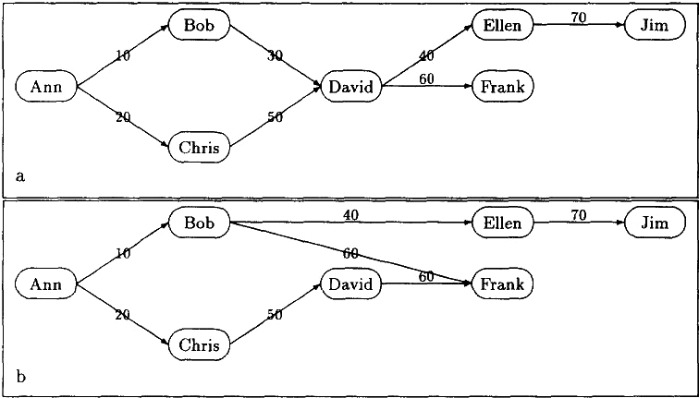
Discretionary Access Control (DAC)
Example:
Fig 3: Bob revokes the privilege from David without cascade

Slide 18
Discretionary Access Control (DAC)
Trojan Horse Attacks:
Drawback of DAC: A subject who is able to read data can pass the data to other subjects not authorized to read the data without the cognizance of the data owner . This weakness makes DAC vulnerable to malicious attacks such as Trojan Horses

Slide 19
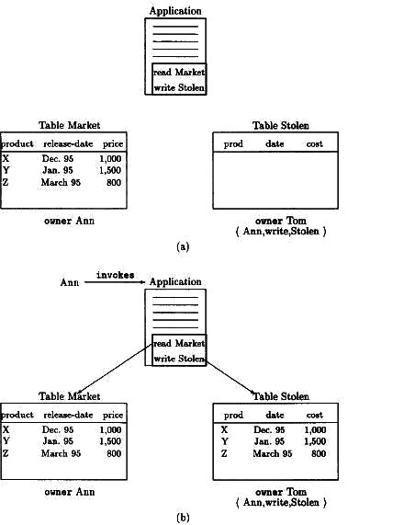
Example of Trojen Horse:

Slide 20
Mandatory Access Control (MAC)
MANDATORY ACCESS CONTROL (MAC): Opposite of DAC and is most restrictive access control model.
MAC security policies govern the access on the basis of the classifications of subjects and objects in the system
An access class consists of two components: a security level and a set of categories.
The security level is an element of a hierarchically ordered set. The levels often considered are Top Secret (TS), Secret (S), Confidential (C) and Unclassified (U), where
TS>S>C>U.
The set of categories is an unordered set, for
example, NATO, Nuclear, Army etc.
Principles that are required to hold are as follows.
Read up – A subject’s integrity level must be dominated by the integrity level of the object being read.
Write down- A subject’s integrity level must dominate the integrity level of the object being written.

Slide 21
Example :
In the previous example of Trojen horse , if Tom is not allowed read access to table Market, under MAC control, table Market will have an access class that is either higher than or incomparable to the access class given to Tom. But then a subject able to read Market would not be able to write table Stolen and hence Trojan horse would not be able to complete its function.
HENCE MAC models are not vulnerable to Trojan horse attacks.

Slide 22
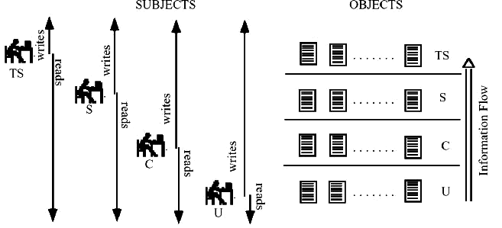
The effect of READ/WRITE rules can be diagrammatically represented as shown:

Slide 23
Role - Based Access Control(RBAC)
ROLE - BASED CONTROL (RBAC):Considered more real world access control than other models because access based on users job function within organisation.
Instead of setting permissions for each user or group assigns permission to particular role in organisation and then assigns users to those roles.
Objects are said to be a certain type, to which subjects with that particular role have access.
Subjects may have multiple roles assigned to them

Slide 24
ROLE - BASED CONTROL (RBAC)
RBAC Terminology
Objects – Any system, resource file, printer, terminal, database record, etc.
Operations - An operation is an executable image of a program, which upon invocation executes some function for the user.
Permissions - Permission is an approval to perform an operation on one or more RBAC protected objects.
Role - A role is a job function within the context of an organization with some associated semantics regarding the authority and responsibility conferred on the user assigned to the role.

Slide 25
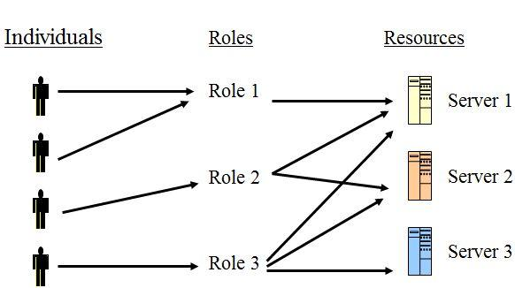
ROLE - BASED CONTROL (RBAC)
RBAC Terminology:
User - A user is defined as a human being or a process executing on behalf of a user.
Group - A set of users.
Constraint – A relationship between or among roles.
Session – A mapping between a user and an activated sub set of the set of roles the user is assigned to.
Role Hierarchy – A partial order relationship established among roles.

Slide 26
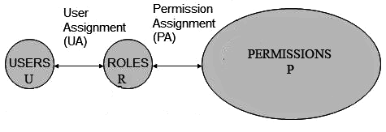
Role - Based Access Control (RBAC)
Model Overview – Flat RBAC

Slide 27
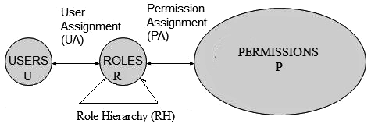
Role - Based Access Control (RBAC)
Hierarchical RBAC :Role hierarchies are a natural means for structuring roles to reflect an organisation’s lines of authority and responsibility

Slide 28
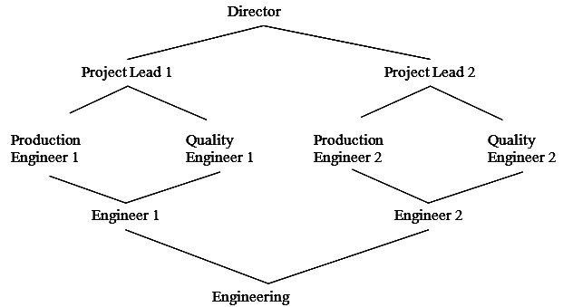
Role - Based Access Control(RBAC)
General Hierarchical RBAC: The diagram below shows a general hierarchy that facilitates both sharing and aggregation.

Slide 29
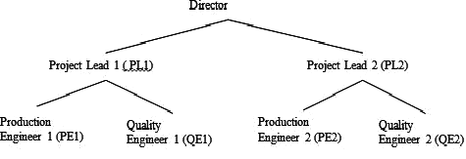
Role - Based Control (RBAC)
Limited Hierarchical RBAC: Hierarchies are limited to simple structures such as trees or inverted trees.

Slide 30
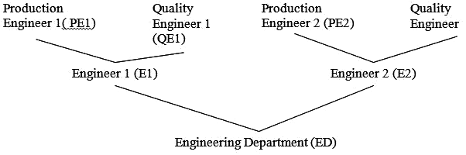
Role - Based Access Control(RBAC)
Constrained RBAC: Constrained RBAC adds constraints to the hierarchical RBAC model. Constraints may be associated with the user-role assignment
An inverted tree hierarchy

Slide 31
Conclusion
Database security is an important goal of any data management system. Database security is based on three important constructs confidentiality, integrity and availability. Access control maintains a separation between users on one hand and various data and computing resources on the other.
Information security is continuously evolving due to the evolution of technology and information systems. Authorization and access control represent a pillar of information security systems.

Slide 32
References
Database Security & Access Control Models: A Brief Overview: Kriti, Indu Kashyap, CSE Dept. Manav Rachna International University, Faridabad, India. https://www.ijert.org/research/database-security-access-control-models-a-brief-overview-IJERTV2IS50406.pdf
A unified attribute-based access control model covering DAC, MAC and RBAC by Xin Jin , Ram Krishnan, and Ravi Sandhu. https://scinapse.io/papers/2097171586
Sustainable Implementation of Access Control by Mihaela Muntean, and Laurenţiu Dijmărescu. https://scinapse.io/papers/2807504979

Slide 33
THANK YOU!!!

